Slide 1

Analysis of German Credit Data
By:
Rohith Movva – U34473539

Slide 2
Content:
Introduction
Problem??
Importance of Problem
What others have done to study
Credit Scoring
Data Complication
Analysis Models
Inferences

Slide 3
Introduction:
Our Modern world depends on credit. Entire economies are driven by people’s ability to ‘buy-Now, pay-later’.
Indeed, 200 years ago it was a privilege to borrow money, but in today’s industrialized societies it is considered as right.
Providing credit is a risky business though, as borrower’s differ in their ability and willingness to pay.
Among the organizations, banks are the firms which conducted and did business with risks.
Credit Risk Management is one of the biggest risks faced by banks and have greater importance in a changing regulatory regime and volatile market conditions

Slide 4

Problem:
When a bank receives a loan application, based on the applicant’s profile the bank has to make a decision regarding whether to go ahead with the loan approval or not. Two types of risks are associated with the bank’s decision –
If the applicant is a good credit risk, i.e. is likely to repay the loan, then not approving the loan to the person results in a loss of business to the bank
If the applicant is a bad credit risk, i.e. is not likely to repay the loan, then approving the loan to the person results in a financial loss to the bank

Slide 5
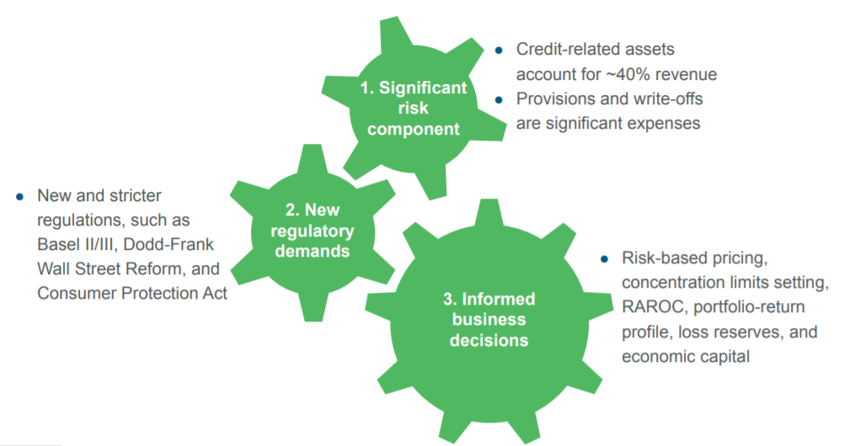
Importance of Problem:
Notes:
The Financial crisis of 2008 exposed the inter-linkages between credit risk, market risk and liquidity. From January 1, 2008 to April 15, 2011, the FDIC (Federal Deposit Insurance Corporation) closed 365 banks that failed to manage the risks building up in their residential and commercial mortgage exposures. Basel III is intended to strengthen bank capital requirements by increasing bank liquidity and decreasing bank leverage.

Slide 6
What others have done to study:
In traditional lending, underwriters make judgmental assessments of prospective borrowers according to the 5 Cs: character(of the applicant), capacity(to borrow), capital(as backup), collateral(as security), and conditions(external factors).
These assessments are based on underwriters’ own experience, and what they have learnt from their mentors, taking into consideration not only historical information, but also a forward-looking view of borrowers’ prospects.
The key was to obtain information through customer relationships, which makes it very difficult for customers to fulfill their dreams.
The use of credit scoring has caused a shift away from relationship lending to transactional lending.
Advances in technology since 1960 have significantly increased the quantity and quality of available credit intelligence, especially in terms of (i) the number of data sources; (ii) the amount of relevant information provided; and (iii) the ease with which it can be acquired, analyzed and summarized.
Notes:
The former is appropriate in communities where lender and borrower had personal knowledge of each other, but is inefficient in an era of high customer mobility and extended branch networks

Slide 7
Continuation:
At the same there has been shift away from secured lending, based upon collateral and guarantees, to unsecured lending, that relies upon information, and repayment out of the next month’s income.
Data has replaced experience, causing underwriters and human judgement to play less role.
The 5 Cs still apply, but credit scores can now capture much of them by extracting maximum value out of available information.

Slide 8
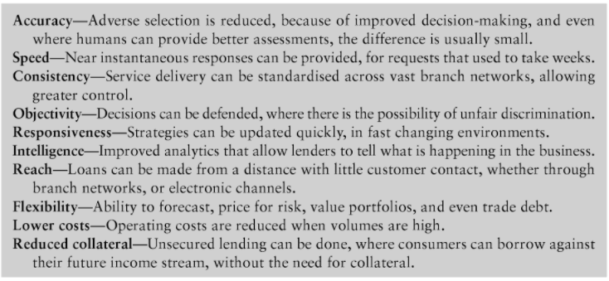
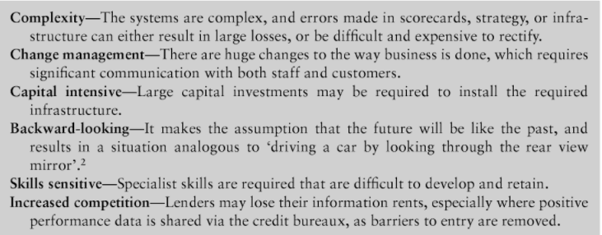
Credit Scoring:
The advent of credit scoring brought this industrialization into the realm of decision-making.

Slide 9
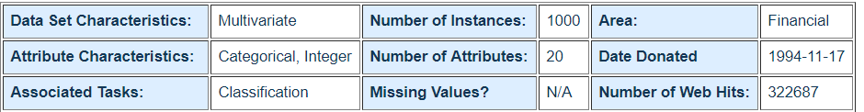
Data Complication:
This Dataset classifies people described by a set of attributes as good or bad credit risks.
Data taken from
http://datahacking.tech/csv-german-credit-data-statlog/
https://archive.ics.uci.edu/ml/datasets/Statlog+(German+Credit+Data)
Anderson, R. (2007). The credit scoring toolkit: Theory and practice for retail credit risk management and decision automation.

Slide 10
Analysis Models:
The following analytical approaches are conducted:
Logistic regression—Here we have conducted with 40%, 50% & 75% Threshold. Accuracy-64%, 60.6% & 45% resp.
Discriminant Analysis---Both Linear and Quadratic Discriminant Analysis---Accuracy-60.8% & 58.2% resp.
Tree-based method---Accuracy-71.6%
Random Forest---Accuracy-73.4%

Slide 11
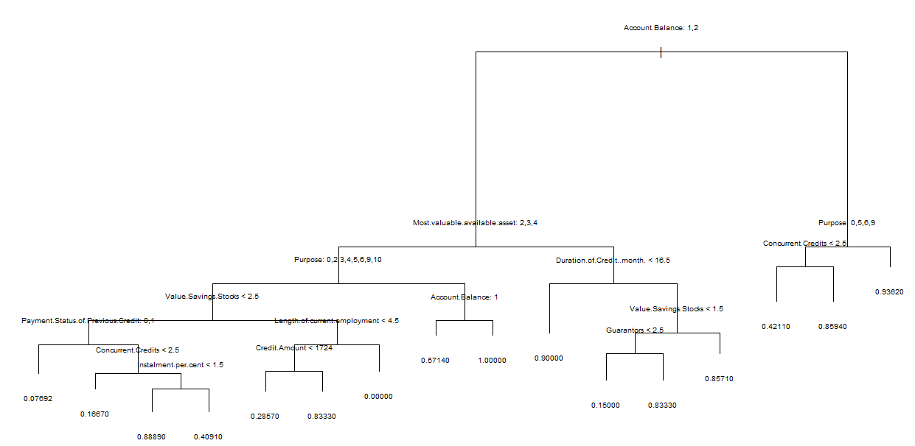
Tree Plot

Slide 12
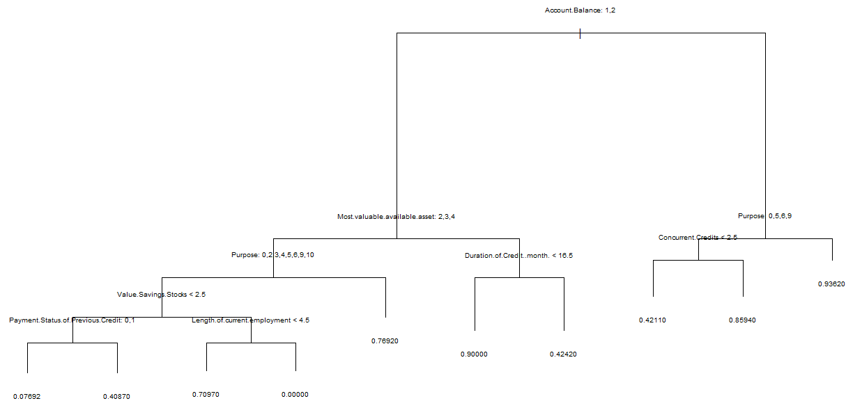
Pruned Tree Plot (best=8)

Slide 13
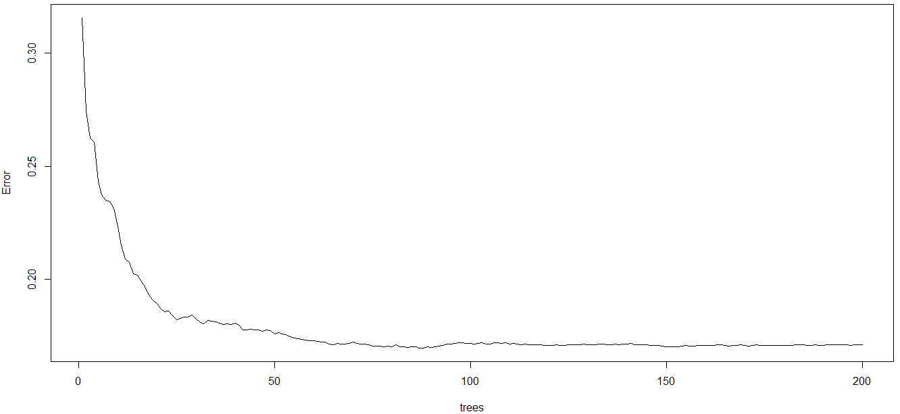
Random Forest Plot

Slide 14
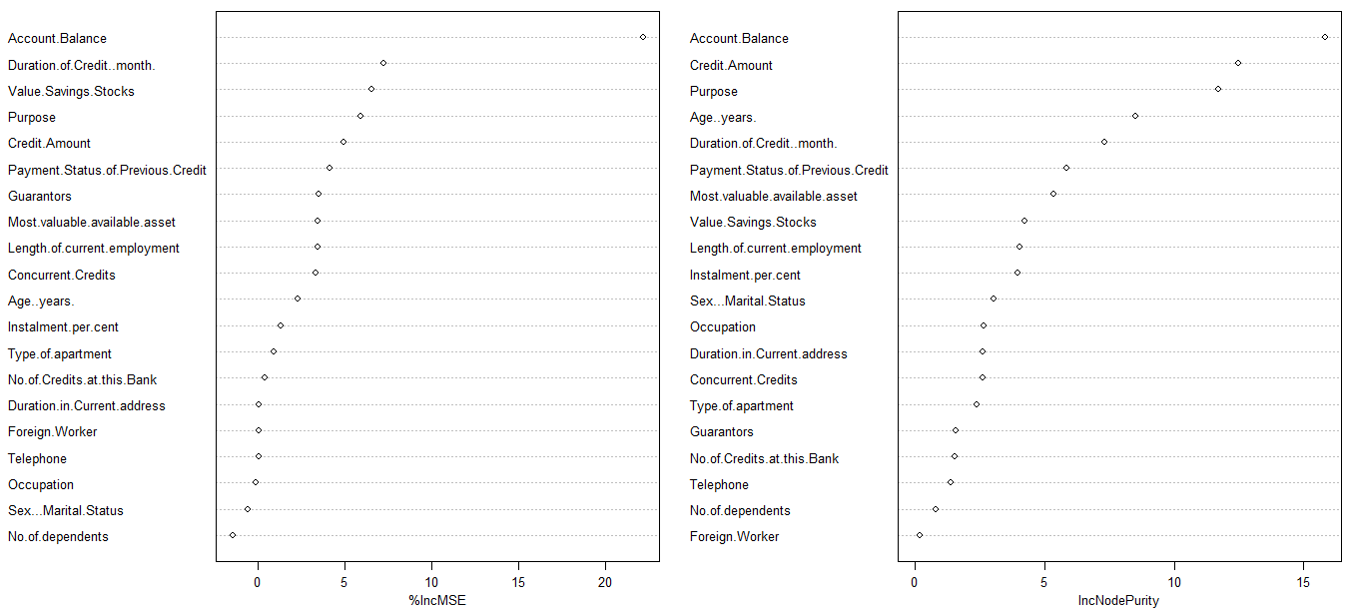
Random Forest Variable Importance Plot

Slide 15
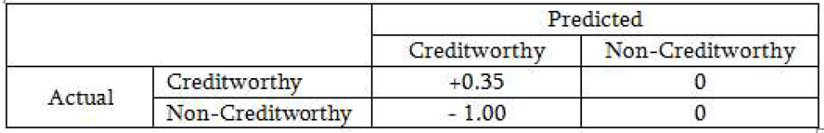
Inferences:
Cost Profit Consideration:
Assumption-A correct judgement by the bank would result in 35% profit at the end of 5 years.
However, a wrong decision by the bank would leave them a loss of 100% at the end of same period.

Slide 16
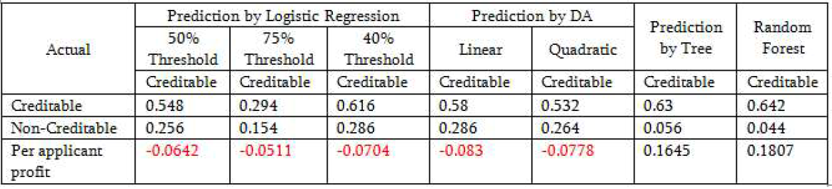
Inferences:
Out of 1000 applicants, 70% are credit-worthy. A loan manager without any model would incur a loss of [(0.7*0.35)+(0.3*-1)] = -0.055 or loss of 0.055 units.

Slide 17
Thank You

